Slide 1
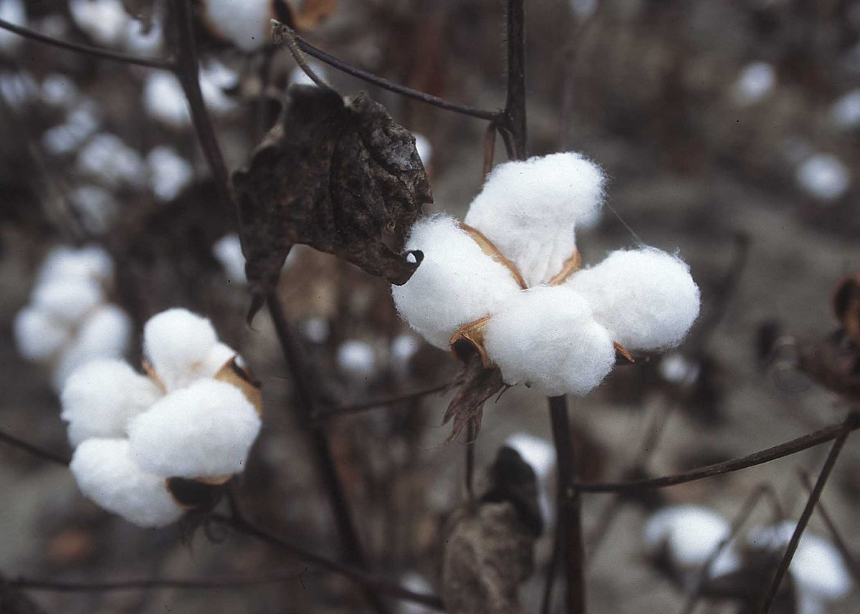
THEORY
Cotton fibres show good durability and utility. It
is a stable material; it stays undamaged even in
the conditions of high exposure of weak acids
and alkalis.
It has high water absorbing capacity. Cotton
fabrics are easy to dye, they have very low
elasticity characters. They are easy washable
and can be ironed even at very high
temperatures.

Slide 2
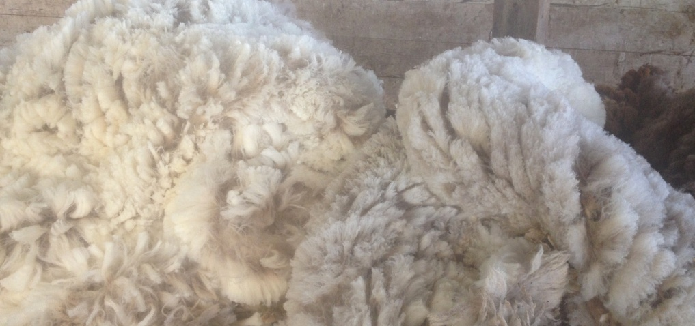
WOOL
Woolen fibres are high moisture absorbers too.
They take up moisture in vapour form.
It generates heat when it absorbs moisture.
Each wool fibre is a molecular coil-spring,
making the fibre remarkably elastic.
They have highly durablility and resilience.
Nature has folded the chemical polypeptide
chains back upon themselves in such a way that
they act like a coiled spring which elongates
when it is extended and retracts when it is
released.

Slide 3
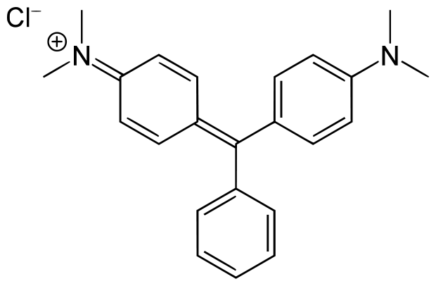
MALACHITE GREEN
Malachite Green is an organic compound that is used as a dyestuff and controversially as an antimicrobial in aquaculture. Malachite green is traditionally used as a dye for materials such as silk, leather, and paper. Although called malachite green, this dye is not prepared from the mineral malachite - the name just comes from the similarity of colour.
Chemical formula: [C6H5C(C6H4N(CH3)2)2]Cl
Common Name: Triarylmethane dye.
Structure:

Slide 4
PROCEDURE
 Preparation of sodium carbonate solution:
Take about 0.5g of solid sodium carbonate and
dissolve it in 250ml of water.
 Preparation of tartaremetic solution:
Take about 0.2g of tartaremetic and dissolve it in
100ml of water by stirring with the help of glass
rod.
 Preparation of tannic acid solution:
Take 100ml of water in a beaker and add about
1.0g of tannic acid to it. Heat the solution. On
heating a clear solution of tannic acid is obtained.
 Preparation of dye solution:
Take about 0.1g of malachite green dye and add
to it 400ml of water. Warming results in a clear
solution of the dye.
 Dyeing of wool:
Take about 200ml of dye solution and dip in it the
woolen cloth to be dyed. Boil the solution for
about 2 minutes. After that remove the cloth and
wash it with hot water 3-4 times, squeeze and
keep it for dyeing.

Slide 5
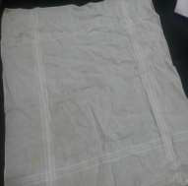
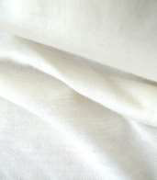
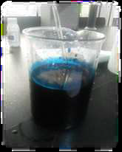
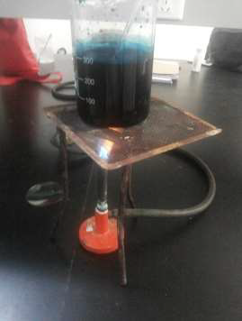
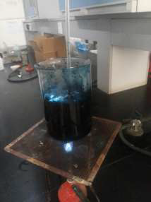
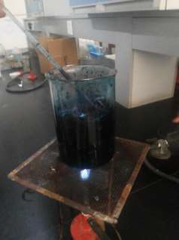
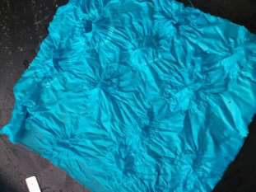
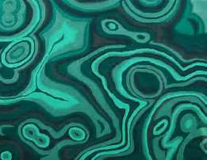
REQUIREMENTS AND PROCEDURE
COTTON WOOLEN MALACHITE
WHITE WHITE GREEN
CLOTH CLOTH SOLUTION
BOILING COTTON WOOLEN
OF CLOTH IN CLOTH IN
MALACHITE MALACHITE MALACHITE
GREEN GREEN GREEN
SOLUTION SOLUTION SOLUTION
DYED
COTTON DYED WOOLEN
CLOTH CLOTH

Slide 6
 Dyeing of cotton: Cotton does not absorb malachite green readily, therefore it requires the use of a mordant. For dyeing a cotton cloth dip it in sodium carbonate solution for 10 minutes and then rinse with water. Then put the cloth in hot tannic solution for about 5 minutes. Now take out the cloth from tannic acid solution and keep it in tartaremetic solution for about 5 minutes. Remove the cloth and squeeze it with spatula to remove most of the solution. Now place the cloth in boiling solution of the dye for about 5 minutes. Remove and wash the dyed cloth thoroughly with water, squeeze and keep it for drying.  Dyeing of cotton directly: Take another piece of cotton cloth and put it directly into boiling solution of the dye. Keep it dipped for about 2 minutes. Remove the cloth, wash it with water, squeeze and keep it for drying.

